Slide 1
INTRODUCTION

Slide 2
AGENDA
Operating System & Types of Operating System.
Redhat Overview.
Filesystem & Types of File System.
Boot Loaders & Types of Boot Loaders.
Linux Architecture Overview.
Types of User Accounts.

Slide 3
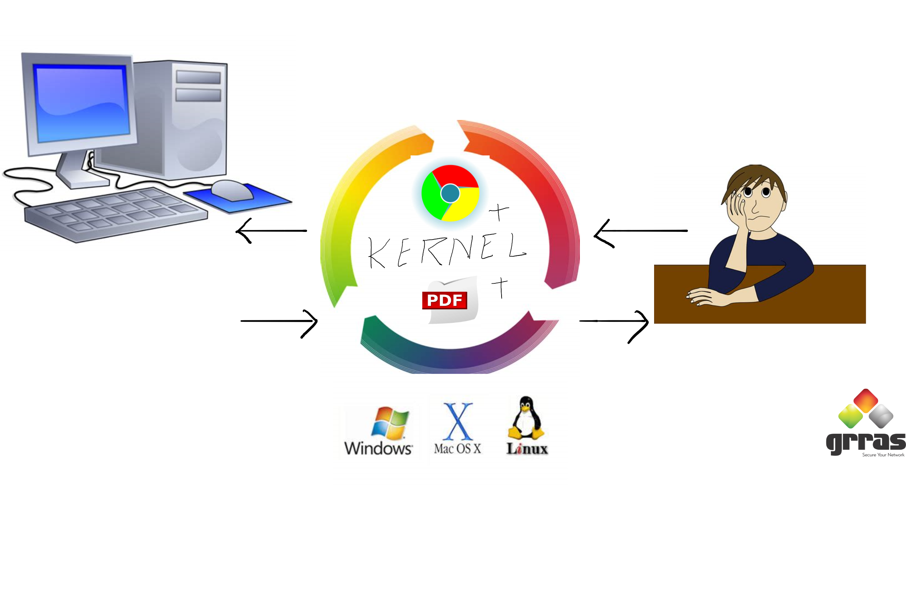
OPERATING SYSTEM & TYPES OF OPERATING SYSTEM

Slide 4
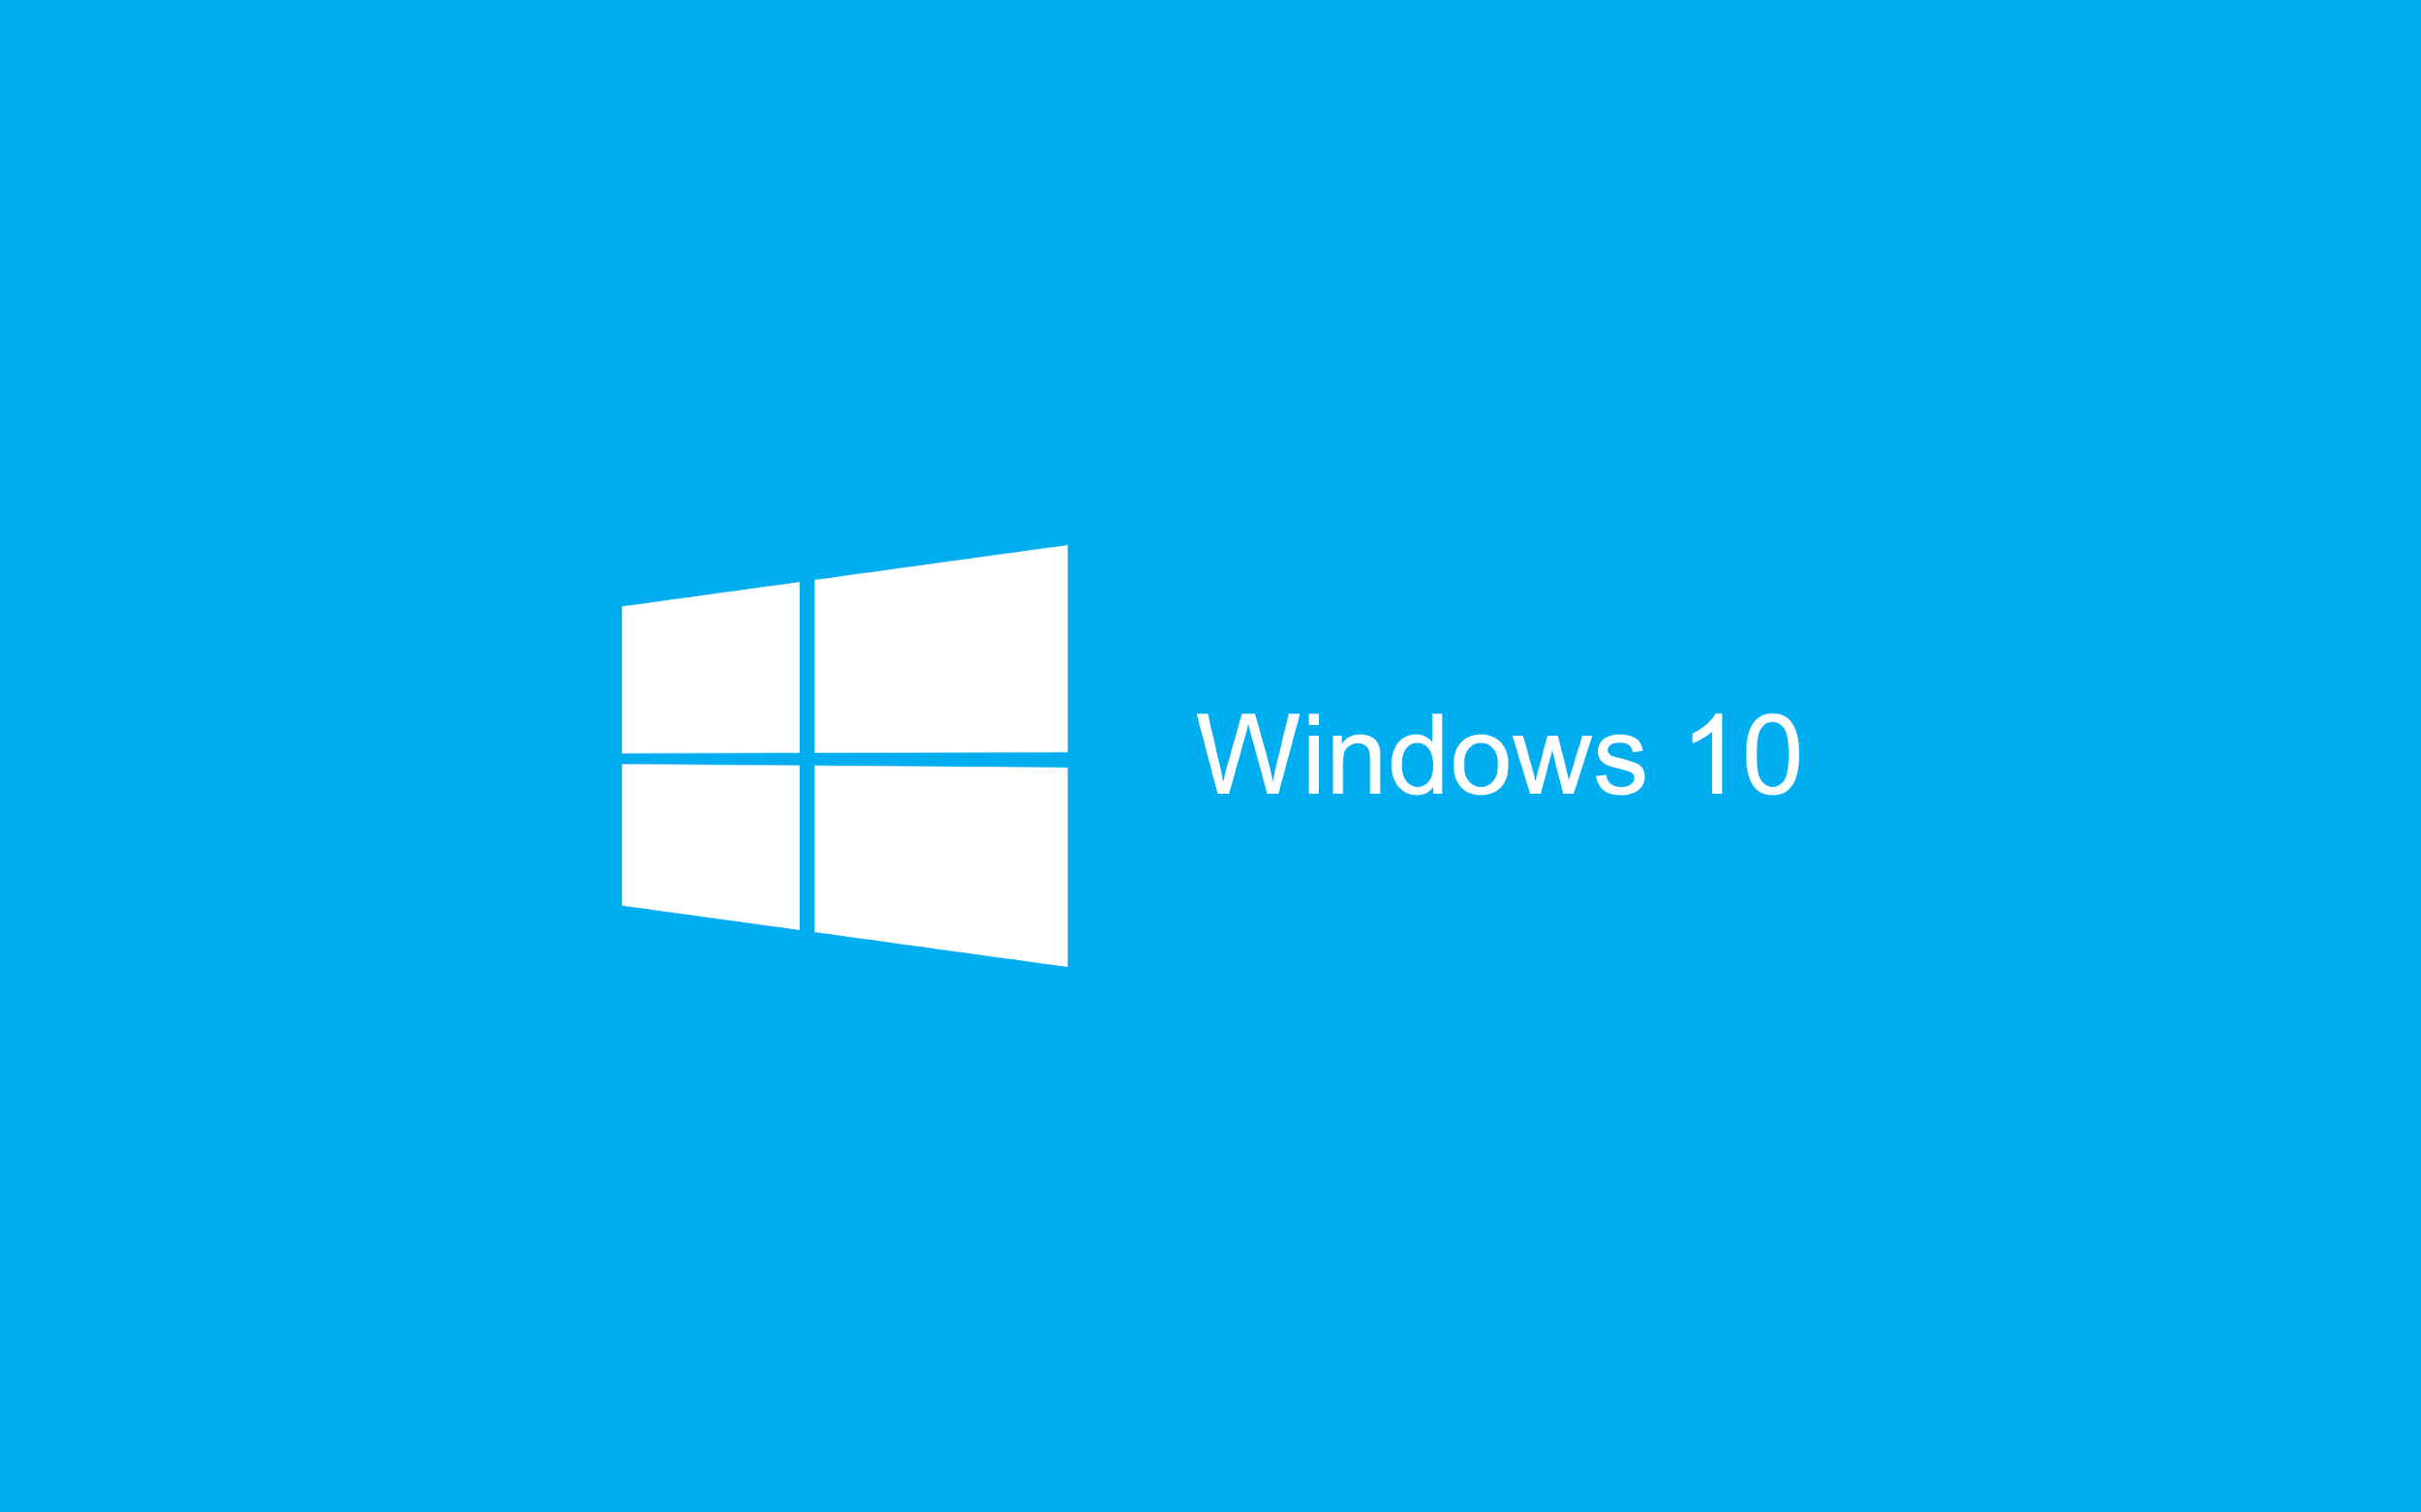


OPERATING SYSTEM & TYPES OF OPERATING SYSTEM
WINDOWS
LINUX
UNIX

Slide 5
REDHAT OVERVIEW
Redhat is the worlds largest open source company.
RHEL(Redhat Enterprise Linux).
Redhat Certifications Demands.
Redhat Products
Red Hat was founded on March 26, 1993

Slide 6
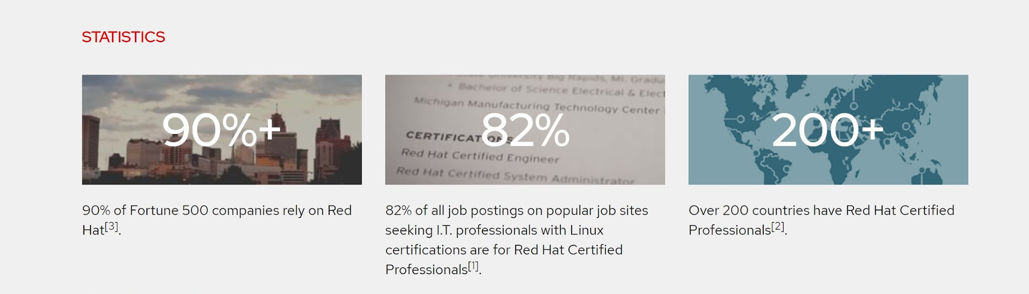
REDHAT CERTIFICATION FACTS

Slide 7
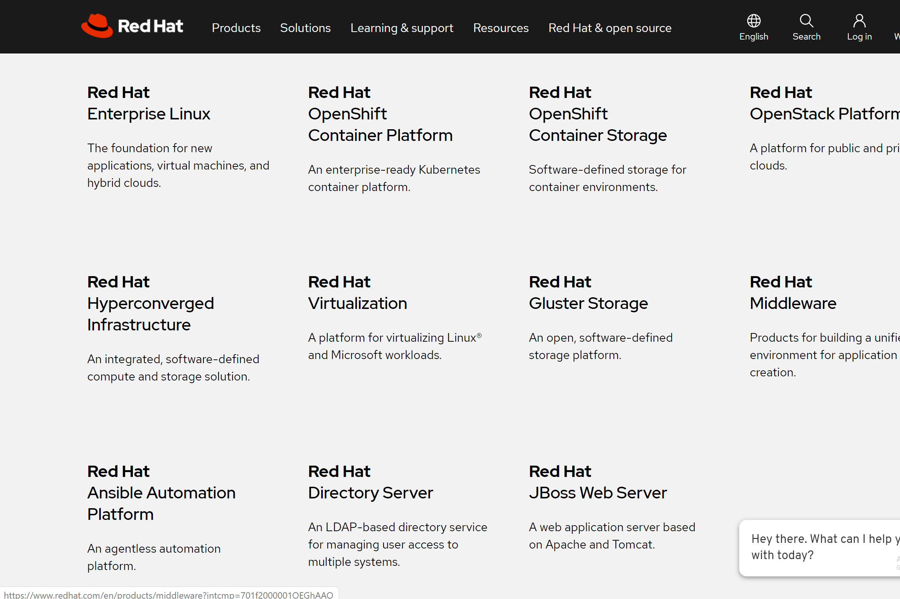
REDHAT PRODUCTS

Slide 8
FILESYSTEM & TYPES OF FILESYSTEM
File system control how data is stored & retrived.
Different Operating system have there different filesystem.
The Structure and logic rules used to manage the group of data and their names is called a file system.
FAT, NTFS, EXT4, XFS, HDFS etc.

Slide 9
BOOT LOADERS & TYPES OF BOOT LOADERS
Boot loader is a small program help to load an operating system in memory.
GRUB
NTLDR
LILO
GRUB2

Slide 10
LINUX ARCHITECTURE
Master drive of linux system.
/
Stored binary , documents & software.
/USR
Store variable data
/VAR
Store booting related data
/BOOT
Store temprory files
/TMP
Store users informations
/HOME
Virtual memory
SWAP

Slide 11
TYPES OF USERS
Full privileges
Adminstrator User
Application associated user
System User
Least privilege account
Local User

